Slide 1

Testing the Ground Circuit
• Ground of electrical products
• Class I vs. Class II products
• Ground Continuity Test
• Ground Bond Test
• What is tested during each test

Slide 2

Meet Our Team

Slide 3


Webinar Notes
Please use the Q & A utility to ask us any questions concerning the material being presented.
You can find a recording of this webinar and presentation on our Webinar Archive page, https://www.arisafety.com/webinars/archived-webinars/
Please contact Brittany Socha – on the chat line or email Brittany.socha@ikonixusa.com if you have any connection issues.

Slide 4

Ground Bond & Ground Continuity Testing Learning Objectives
What is Ground?
Grounding of electrical products
Class I vs. Class II products
Ground
Ground Bond
The Ground Bond Test – What is it?
Ground Bond Standards Information
Ground Bond Testing Examples
Ground Continuity
The Ground Continuity Test – What is it?
Ground Continuity Standards Information
Ground Continuity Testing Examples
Bond vs. Continuity
Comparing the Ground Bond and Ground Continuity tests
Example of Ground Bond vs Ground Continuity
Notes:
Important to understand what a ground

Slide 5
What is Ground?
Reference point for an electrical circuit
Second line of defense against electrical shock¹
Common return path for electrical current²
Ground or “earth” can have numerous functions and meanings. The main purpose of a ground is to reduce the risk of electrical shock.
1 – http://en.wikipedia.org/wiki/Ground_%28electricity%29#mediaviewer/File:HomeEarthRodAustralia1.jpg
2 - http://www.howequipmentworks.com/physics/electricity/elec_safety/electrical_safety.html

Slide 6
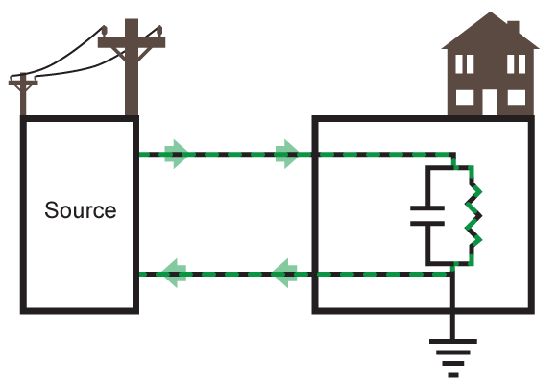
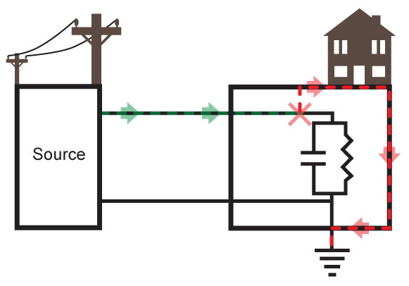
Modern Power Distribution

Slide 7
Different Functions of Ground
Service Ground
Equipment Ground
Ground or “Earth”
System or Service ground – designed to protect machines, tools and insulation.
Equipment Ground – Designed to protect operator from electrical shock hazards.

Slide 8
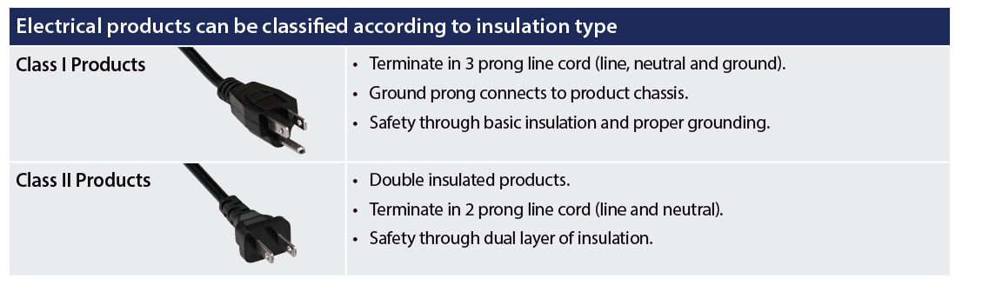
Class I vs. Class II Electrical Products
Class I products provide electrical protection by employing basic insulation and a grounded chassis. Class II products employ a double layer of insulation so a grounded chassis is not necessary.

Slide 9
What is Good Ground?
National Electrical Code
NFPA 70
Protect people and property from electrical hazards
”Any exposed non-current carrying metal parts of cord & plug connected equipment which may become energized shall be grounded.”
NEC 250-45
Permanent and Continuous
Capacity to conduct fault current
Low impedance to limit voltage to ground.
NEC 250-51
NFPA (National Fire Protection Agency) stipulates the NEC which is adopted in all 50 U.S. States. The NEC gives requirements for grounding products and installations. The NEC defines a “good” ground.

Slide 10
Ground Bond and Continuity Tests
Ground Bond and Ground Continuity tests are designed to “check” the ground connection on a product or system.
How you ensure you have a proper ground.
Purpose
Apply a current to the ground point of a product or system.
Measure potential drop across the ground circuit and calculate the circuit resistance.
Method
• Ground Bond are generally TYPE TESTS.
• Ground Continuity are generally PRODUCTION TESTS.
Permanent and Continuous
Capacity to conduct fault current
Low impedance to limit voltage to ground.
Testing
These two types of tests are used to prove and verify that there is a low impedance path to the ground for electrical products and systems. This ensures proper grounding.

Slide 11

Quiz Question
Which of the following best represents the result of a ground Bond test?

Slide 12
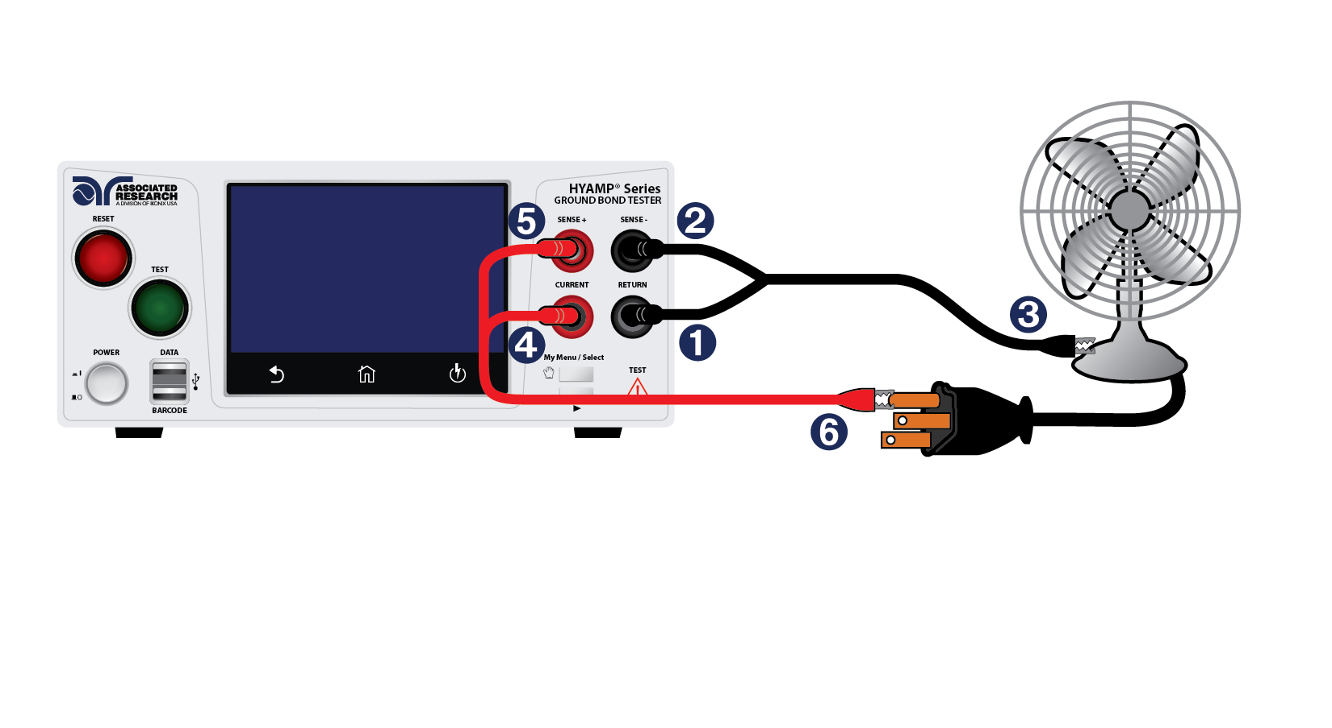
The Ground Bond Test
Associated Research HYAMP connected to
a DUT (Device Under Test)

Slide 13
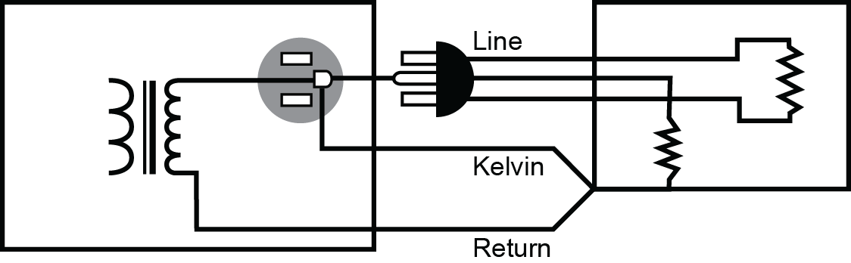
Ground Bond Testing

Slide 14
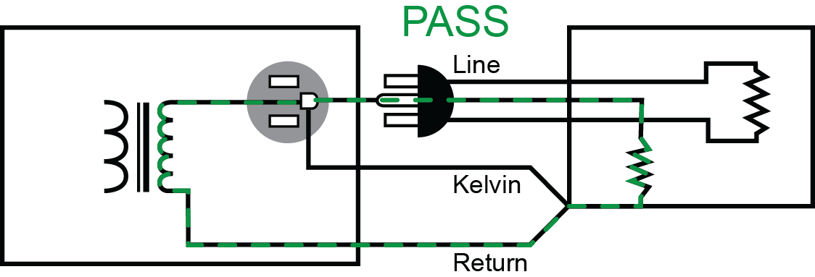
Ground Bond Testing

Slide 15
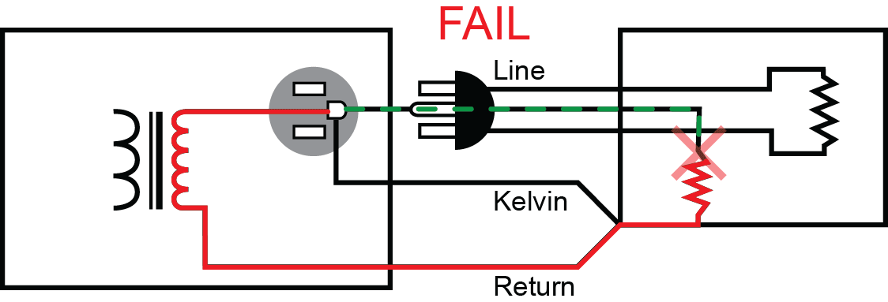
Ground Bond Testing

Slide 16
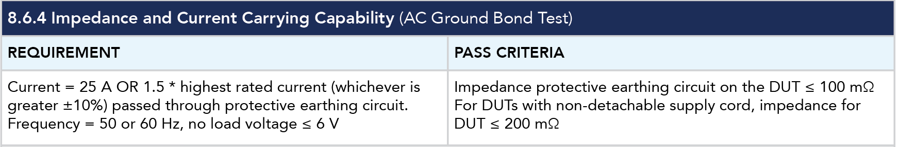
By the Numbers – What the Standards State
IEC/UL 60601-1 3rd Edition

Slide 17
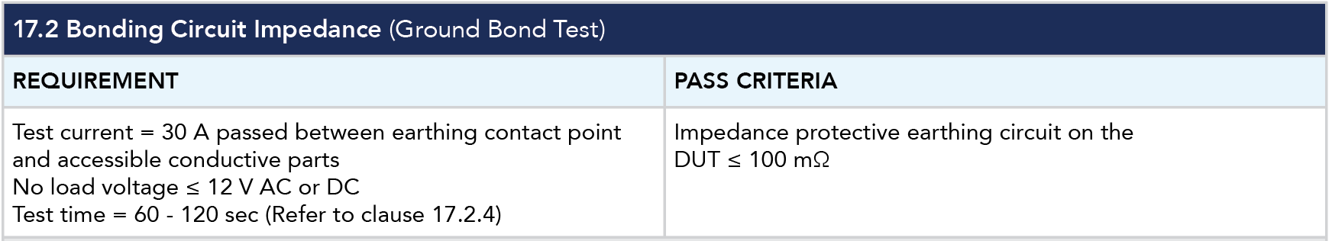
By the Numbers – What the Standards State
UL 1598/CSA C22.2 No. 250.0-08 3rd Edition Luminaires

Slide 18
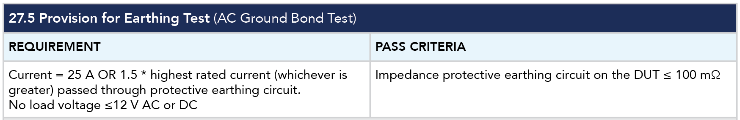
By the Numbers – What the Standards State
IEC/UL 60335-1 5th Edition

Slide 19
Ground Continuity Testing
Purpose
A DC low current test to check circuit resistance.
Similar concept to the Ground Bond testing.
Method
Not all readings display on Ohmic value
Light/buzzer meters to check whether continuity exists.
Ground Continuity testing is the same concept as Ground Bond testing. You’re simply checking for a continuous path on a ground circuit. However, there are key differences between these two tests.

Slide 20
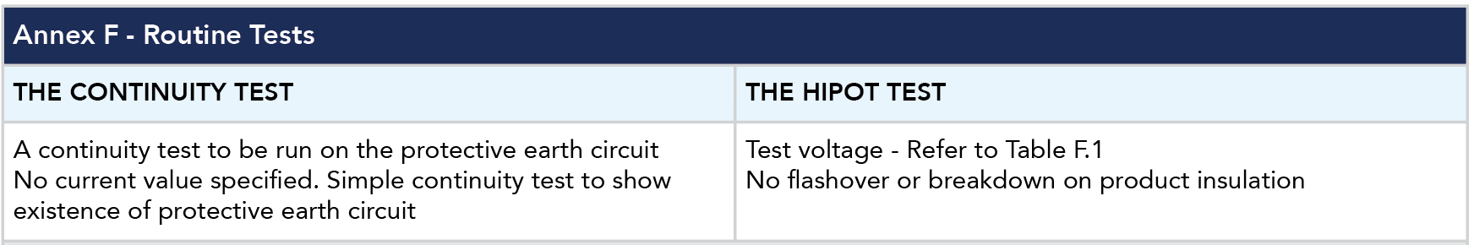
By the Numbers – What the Standards State
IEC/UL 61010-1 3rd Edition

Slide 21
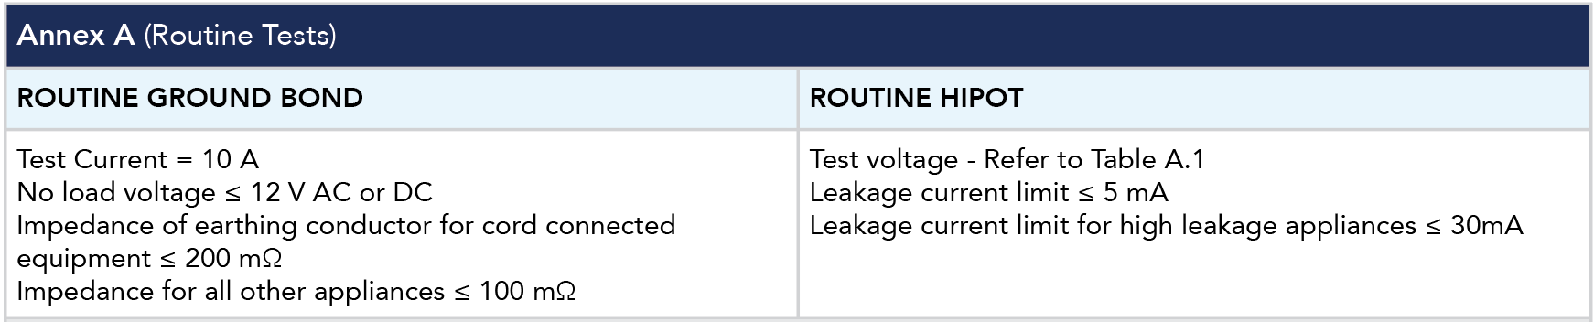
By the Numbers – What the Standards State
IEC/UL 60335-1 5th Edition

Slide 22
Ground Bond Vs. Ground Continuity
Ground Continuity Test | Ground Bond Test
• Verifies the existence of a ground connection • Readings generally given in Ωs • The test is quick to set up and easy to perform • Usually used as an extra feature during the Hipot test. | • Verifies the integrity of a ground connection • Readings generally given in mΩ • Provides more valuable safety information about DUT • Can be combined with a Hipot test for a more complete safety testing system.
The Ground Bond test is more stringent than
the Ground Continuity test.

Slide 23
Ground Bond Vs. Ground Continuity
Example: 64 strand wire with all but one strand connected.

Slide 24

Ground Bond Vs. Ground Continuity
Example: 64 strand wire with all but one strand connected. A ground continuity test would pass this wire because the instrument reads a continuous path.

Slide 25

Ground Bond Vs. Ground Continuity
Example: A Ground Bond test load the wire with high current. This would
“burn up” the connection and cause a FAIL.

Slide 26
Poll Question
When are you performing the Ground Bond test on your product?

Slide 27

Video Demonstration

Slide 28
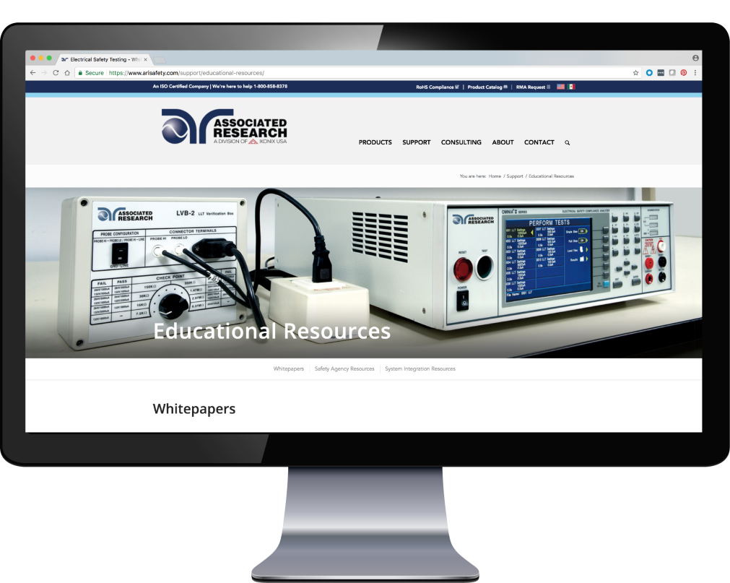
Educational Resources
Visit us online to view all of our Educational Resources
arisafety.com/support/educational-resources/

Slide 29

Join Us
Our Next Webinar is
An Introduction to Power Sources (APT)
Wednesday, September 12 at
10AM CST (GMT – 6:00)
Click the link in chat box to learn more
Notes:
Insert next webinar info here

Slide 30
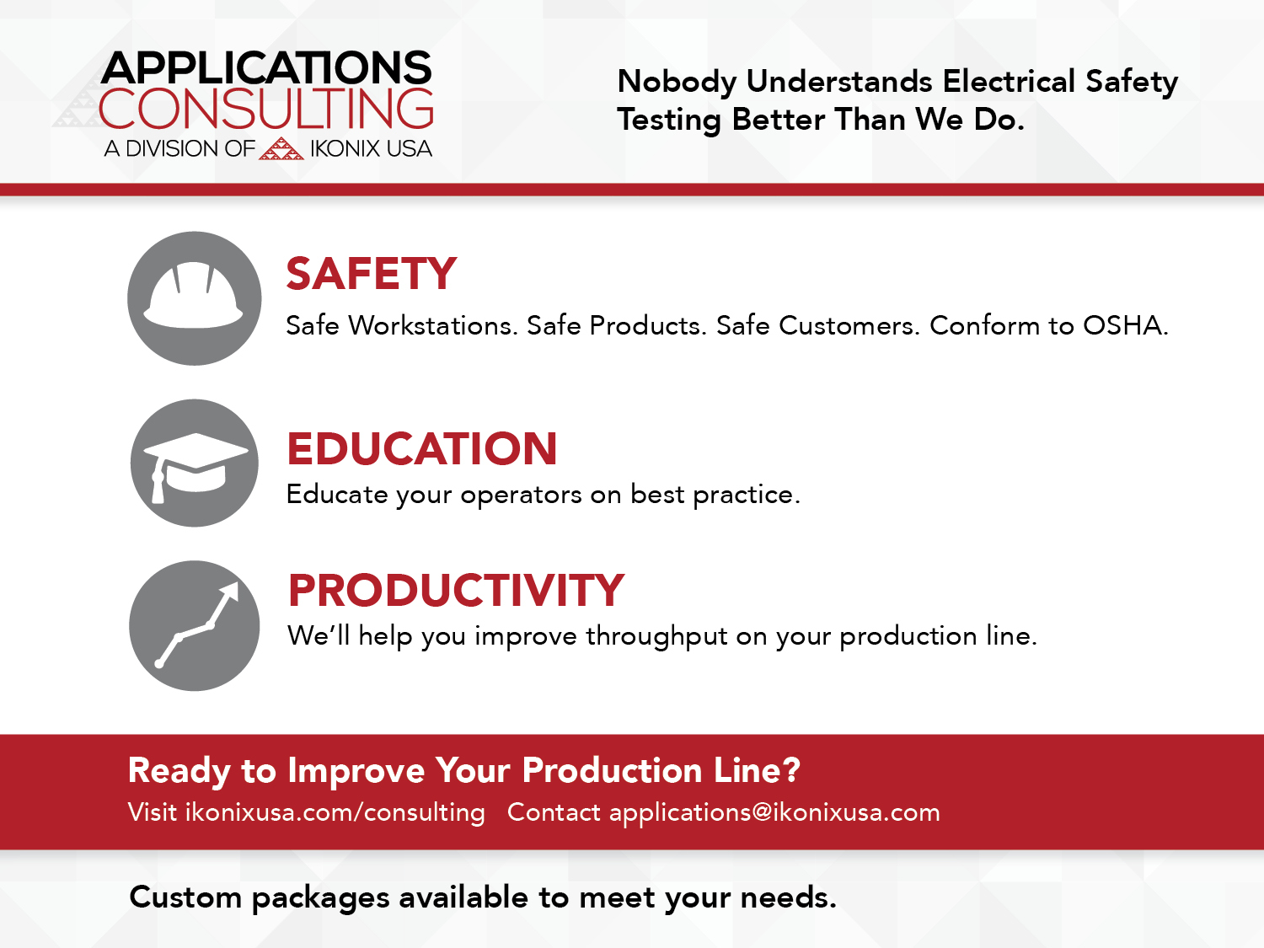

Slide 31

Contact Us
You can find a recording of this webinar and presentation on our Webinar Archive page, https://www.arisafety.com/webinars/archived-webinars/
Check out our website for more information arisafety.com
For any questions about our webinars send an email to Brittany at brittany.socha@ikonixusa.com

